Slide 1
Including scale when analyzing high throughput sequencing datasets (Computational paradigms in molecular biology revisited)
Greg Gloor
ggloor@uwo.ca
@gbgloor
@gbgloor.bluesky.social

Slide 2
How we get our data
Reality
Measurement

Slide 3

Dark underbelly of HTS
Domain-specific tools
Why not treat all HTS data the same?
Dataset-specific workflows/analyses
Why use multiple approaches?
Instability in results
Why does sub-setting change outcomes?
Correlation!
Is there a general solution?
General lack of robustness

Slide 4


Our data in reality
Reality
Measurement

Slide 5



Kudos to start
Andrew Fernandes PhD, Senior Staff Scientist
ShieldAI, San Diego
Justin Silverman MD/PhD, Ass’t Professor
College of Information Science and Technology,
Biostatistics, Medicine, Penn State
Michelle Pistner Nixon PhD, Ass’t Res. Professor
College of Information Science and Technology,
Penn State

Slide 6

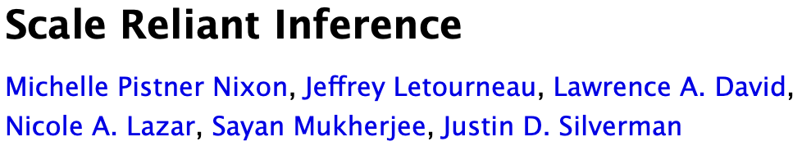
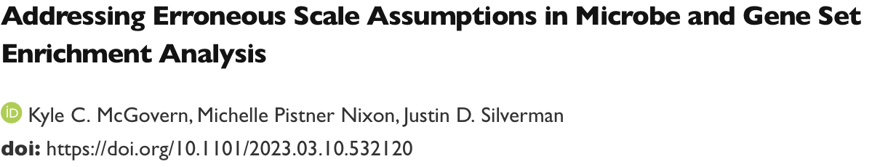

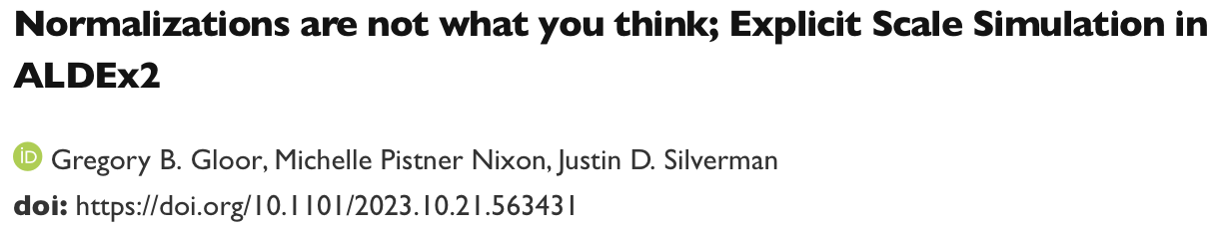
Preprints …
Beyond Normalization: Incorporating Scale Uncertainty in ALDEx2
Michelle Pistner Nixon, Gregory B. Gloor, Justin D. Silverman
Now on V5 of ?

Slide 7
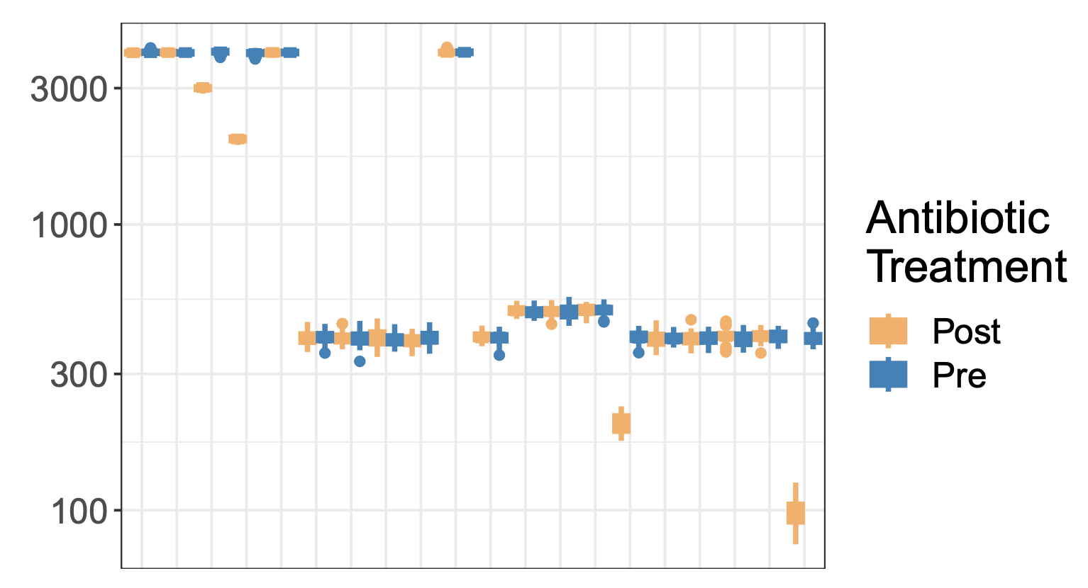
Drivers
‘Bad’ HTS data is shockingly easy to generate
Chemostat experiment
Mis-estimation of scale causes issues for compositional systems
Unacknowledged bias in specifying scale causes commonly observed analysis artefacts

Slide 8
Drivers
‘Bad’ HTS data is shockingly easy to generate
BV v H metatranscriptome dataset
Scale misspecification at play here
H / BV bacterial load ~ 1/10 – 1/100

Slide 9
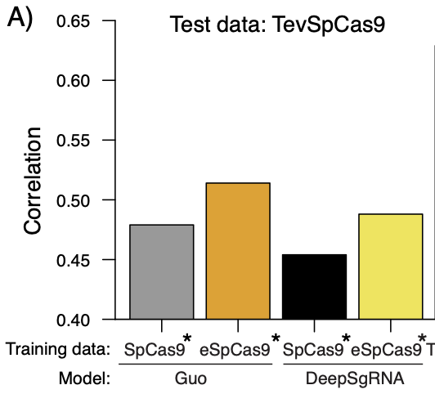
CRISPR SELEX data prediction
Existing model prediction SPCC
Depletion experiments
Internal - 0.633
External ~ 0.5-0.55
ML predictions do not generalize outside of test dataset
Predictions do not generalize to different assays

Slide 10
Formally
The data table is a composition containing only relative data: Y∥
Y∥ is a D x N matrix
We want to know something about the environment: W
W=W∥ W⟂
W is a D x N matrix
Y∥_{dn} ≅ W∥_{dn}
Is a realistic estimate of W hopeless?

Slide 11
Enter Scale (Silverman,Nixon)
Data are normalized to make samples commensurate
Normalizations try to find latent information
Normalizations are ratios (r)
Y^{∥(r)}_{dn}= Y∥_{dn} / 𝑓(Y∥)
True for RPKM, TPM, proportion, RLE, TMM, CLR …
The CLR can be interpreted as a scale
CLR(Y∥) = log₂(Y∥_{dn}) – log₂(G(Y∥_{.n})) = log₂( Y∥_{dn} * 1/G(Y∥_{.n}) )
1/G(Y∥_{.n}) ≅ W⟂_{.n}
CLR resembles: W=W∥ W⟂
Silverman/Nixon showed that these were equivalent
and that this equivalence was useful

Slide 12
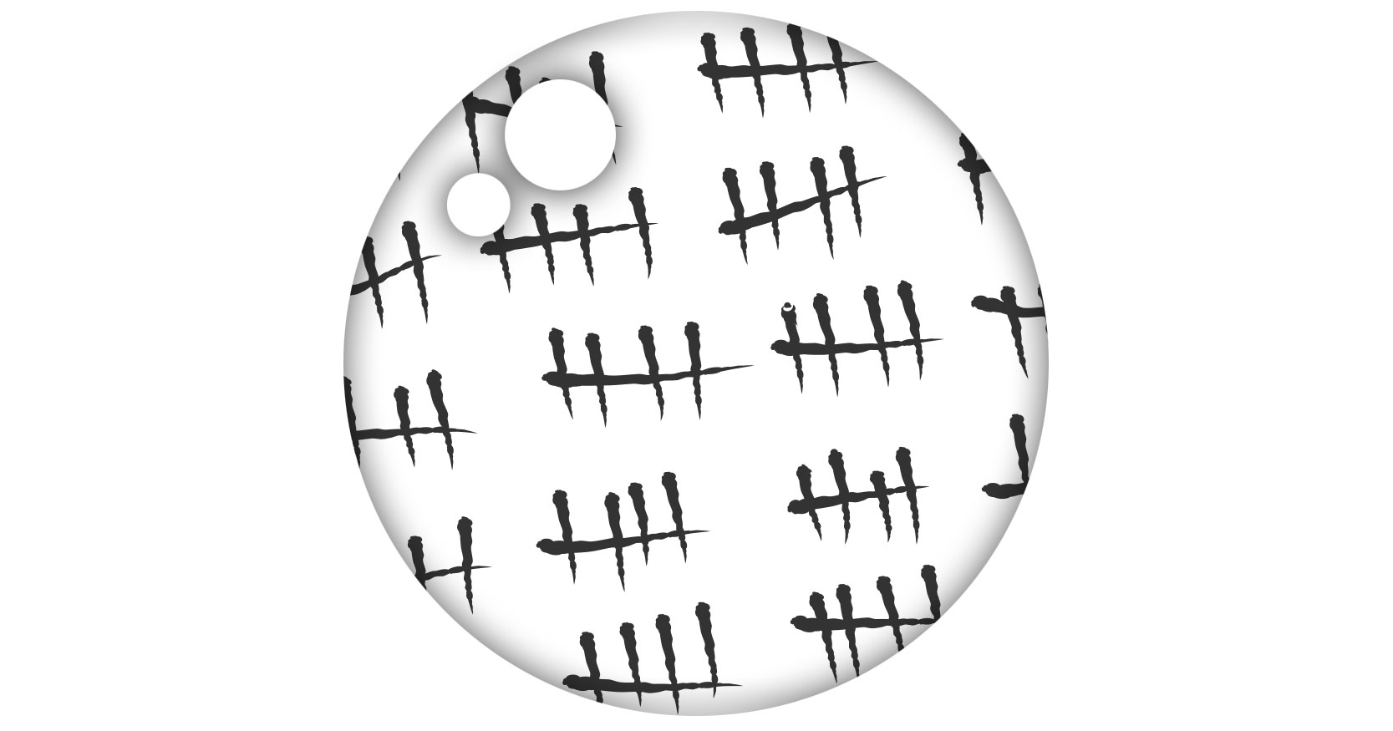
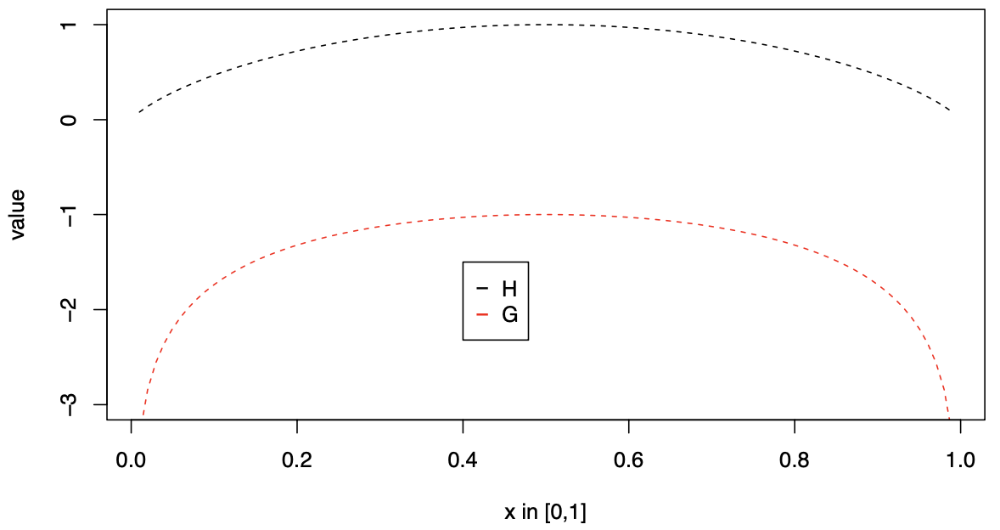
What is scale?
Known counts
Data from cell counting
Data from spike-in controls (but …)
Data from abundance measures
…
Information
log₂(1/G(Y∥_{.n})) = -log₂(G(Y∥_{.n})) = h₂(Y∥_{.n})
Expected Information (Shannon)
log₂(G(Y∥_{.n})) ≅ H₂(Y∥_{.n}) + C + 𝛖
Substitutable!
Entropy interpreted as volume or size in QIT

Slide 13
CLR(Y∥) is a poor approximation of W
Both Y∥_{dn} and G(Y∥_{.n}) are point estimates
All other normalizations less interpretable
Nixon/Silverman show that CoDa/ sequencing is PID and that a full posterior model has less bias
From Gustafson 2015

Slide 14
Let’s build a posterior model (ALDEx2)
Build a posterior model from the observed counts
Ŵ^{∥(s)}_{.n} ≅ Y^{∥(s)}_{.n} = Dir(Y∥_{.n})
Include uncertainty in the scale
Ŵ^{⟂(𝛖)}_{.n} ≅ h(Y∥_{.n}) + 𝛖 = -log₂(G(Y∥_{.n})) + 𝛖
Combine into posterior model of the environment
Ŵ_{.n} = Ŵ^{∥(s)}_{.n} Ŵ^{⟂(𝛖)}_{.n}
‘CLR’ with uncertainty in the numerator and denominator
Can also include uncertainty in the location of Ŵ^{⟂(𝛖)}_{.n} with outside information

Slide 15
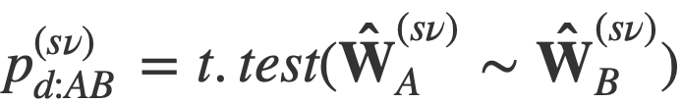
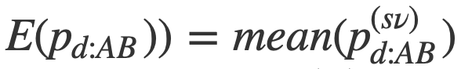
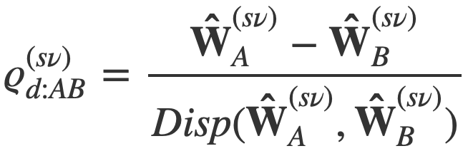
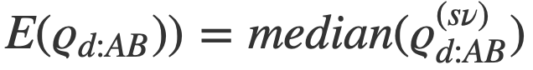
Calculate test statistics (ALDEx2)
Can calculate posterior test statistic if A=d[1:i], B=d[j,n]:
And then an approximate posterior predicted p-value:
And a posterior effect size:
And reduce to point estimate:

Slide 16
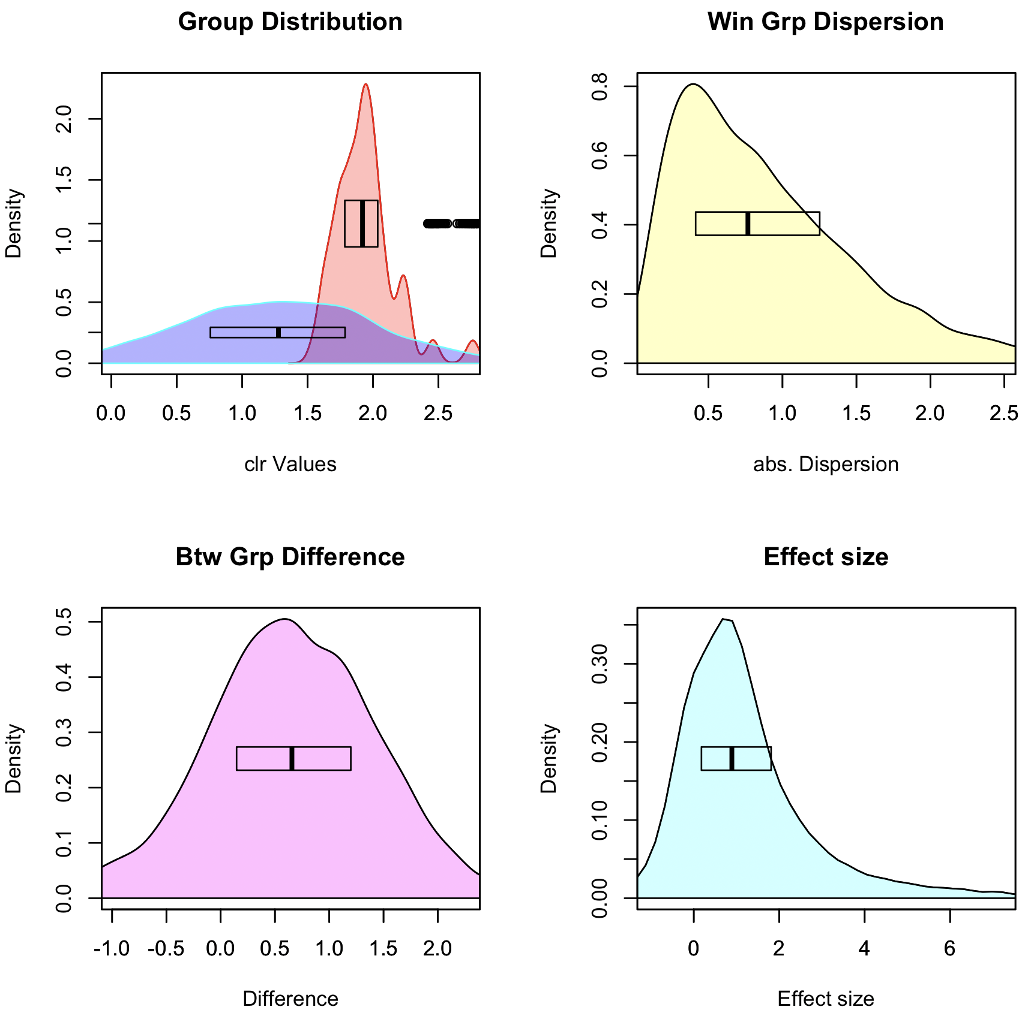
Graphical intuition
Posterior distributions:
rab.A, rab.B
Pooled dispersion: diff.win
Pooled difference: diff.btw
Pooled Effect: effect

Slide 17
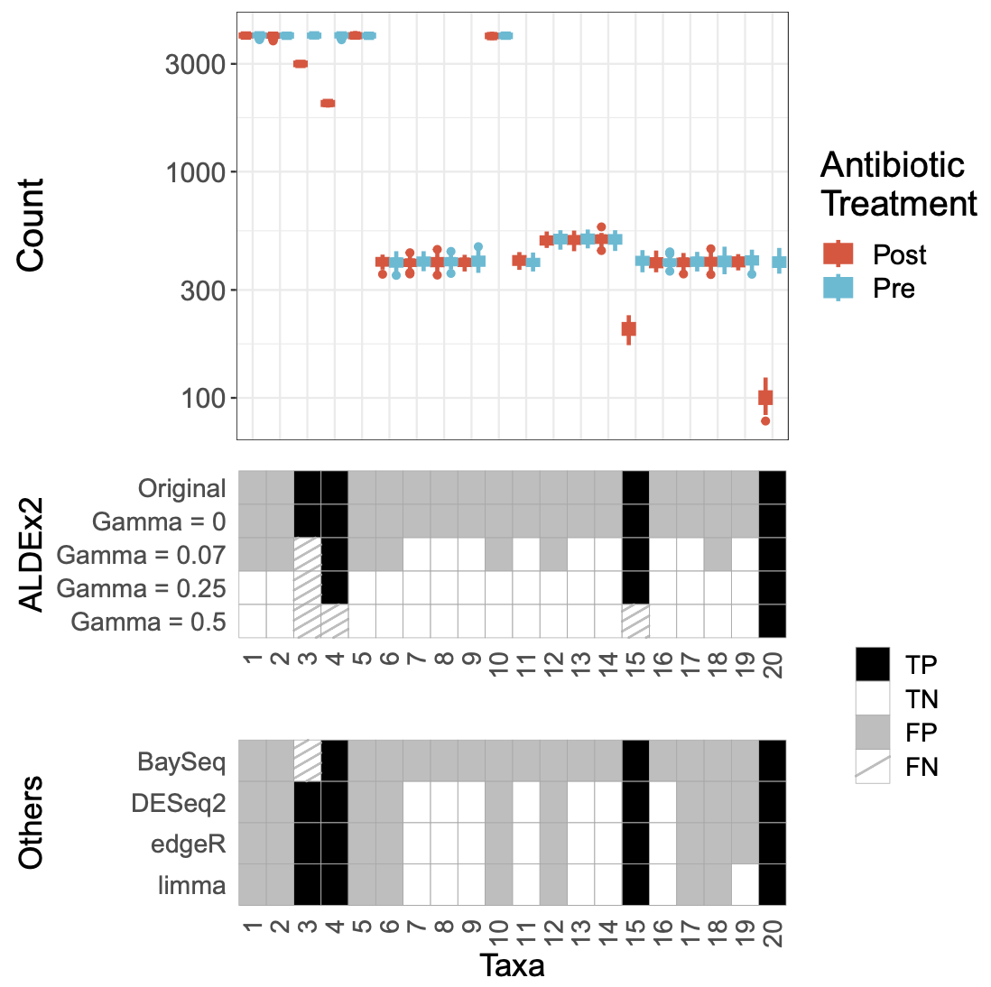
Simulated bioreactor
Simulated bioreactor data
High FP rate across the board
Data are asymmetric
Adding scale removes FP

Slide 18
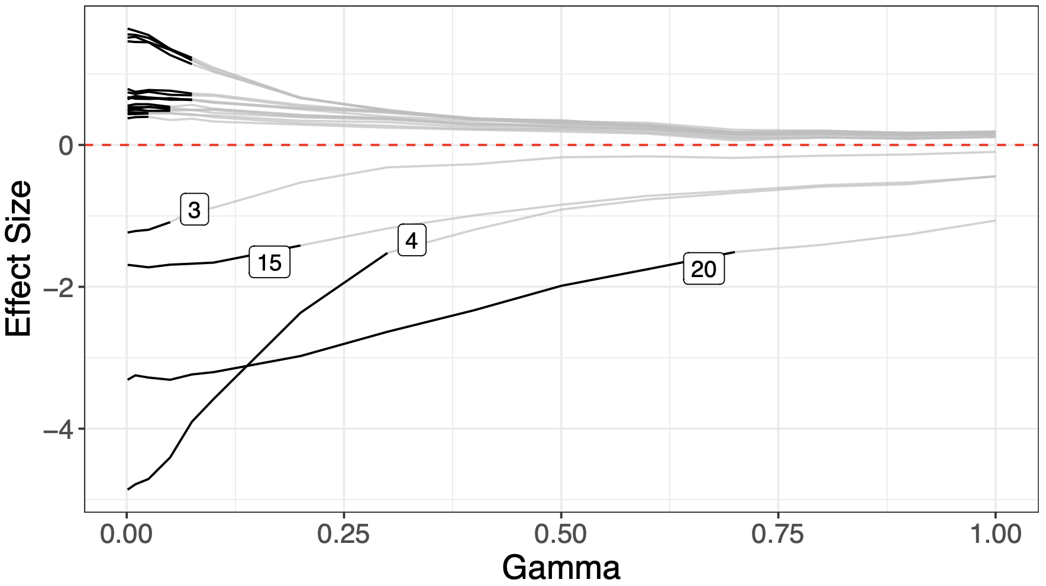
Bioreactor sensitivity analysis
Simulated bioreactor data
High FP rate across the board
Data are asymmetric
Adding scale removes FP
Sensitivity analysis can help find scale settings

Slide 19
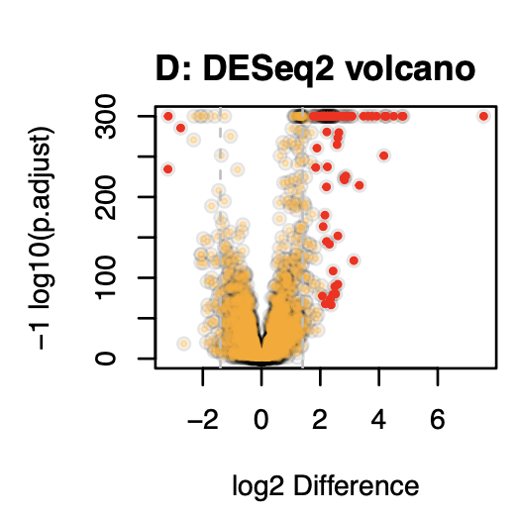
Unacknowledged bias in practice
Observation that too much data is counterproductive (Schurch)
In a highly replicated RNA-seq experiment over 70% of transcripts are DA
Biologically implausible
Breaks assumption of normalization (RLE)
Dual cutoff solution
Jussi (RPE vs HepG2)

Slide 20
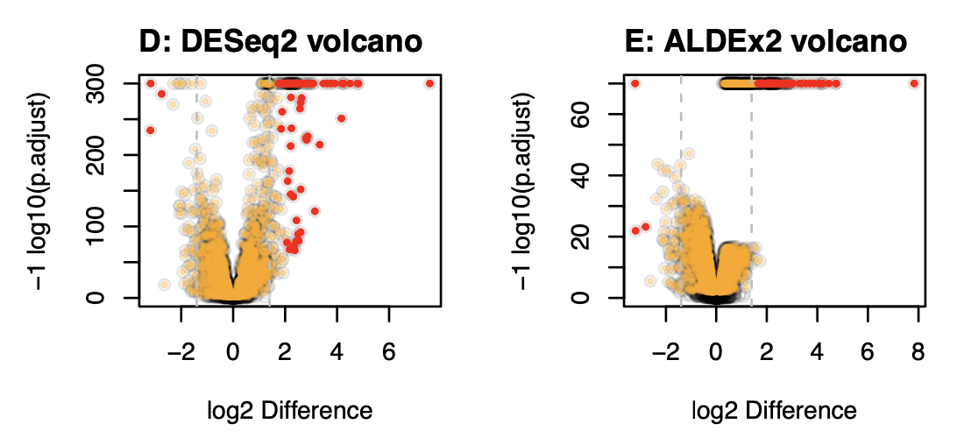
Overpowering is normalization independent
Jussi (RPE vs HepG2)

Slide 21
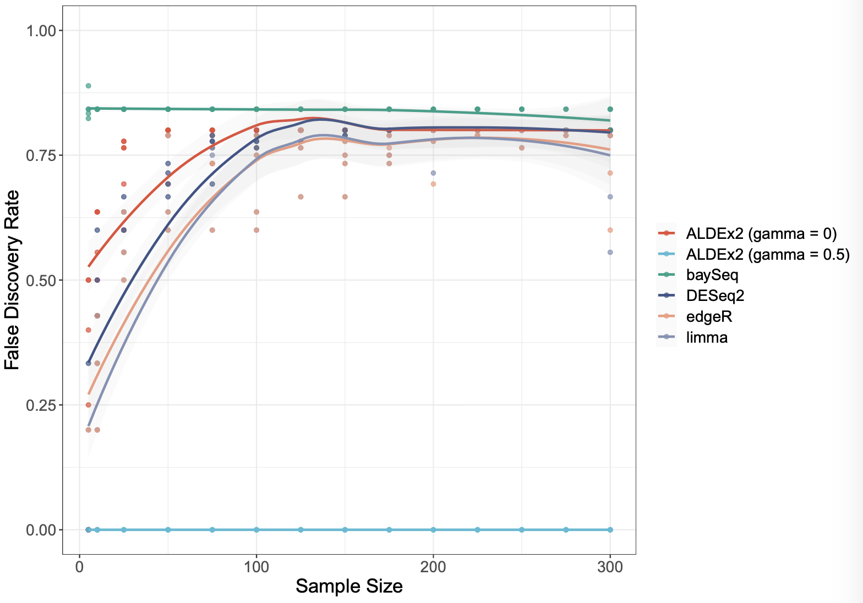
Scale keeps sensitivity, removes overpowering
Simulated bioreactor data
High FP rate across the board
Data are asymmetric
Adding scale removes FP
Sensitivity analysis can help find scale settings
Increasing sample size makes problem worse for all tools but the scaled model

Slide 22
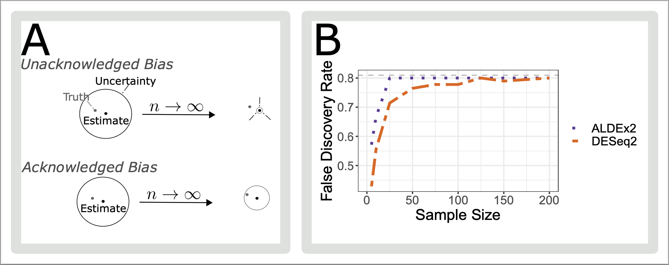
Because - unacknowledged bias

Slide 23
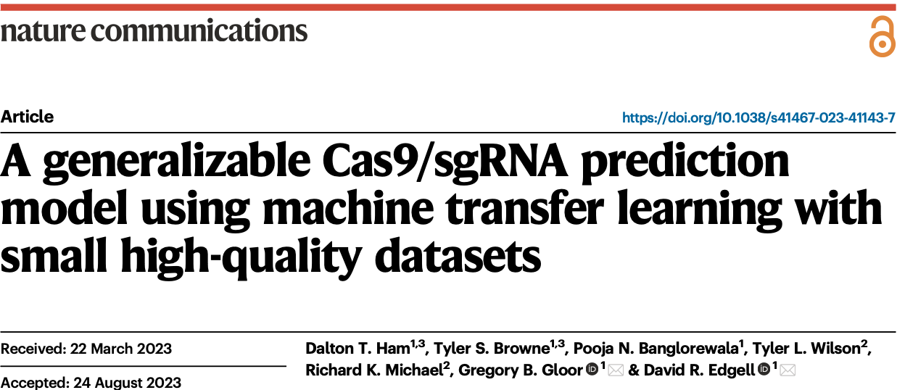
Application to ML

Slide 24
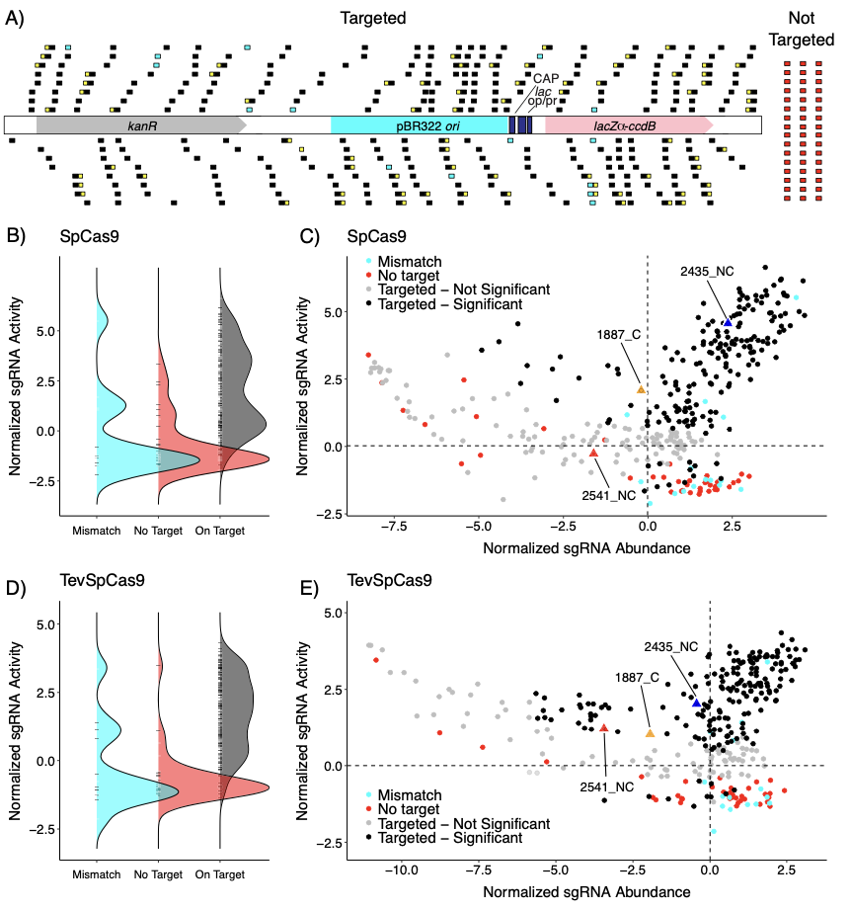
What about ML?
Scaled Bayesian posterior values help increase accuracy
All inputs are linearized by default
Best guess of Ŵ
CRISPR prediction model (Tyler Browne, Dalton Ham)
Re-using existing data and new data
Novel ML architecture
Score based on difference
Predictions transferrable
Predictions ~linear with assays
across species
across nt frequencies
across assays

Slide 25
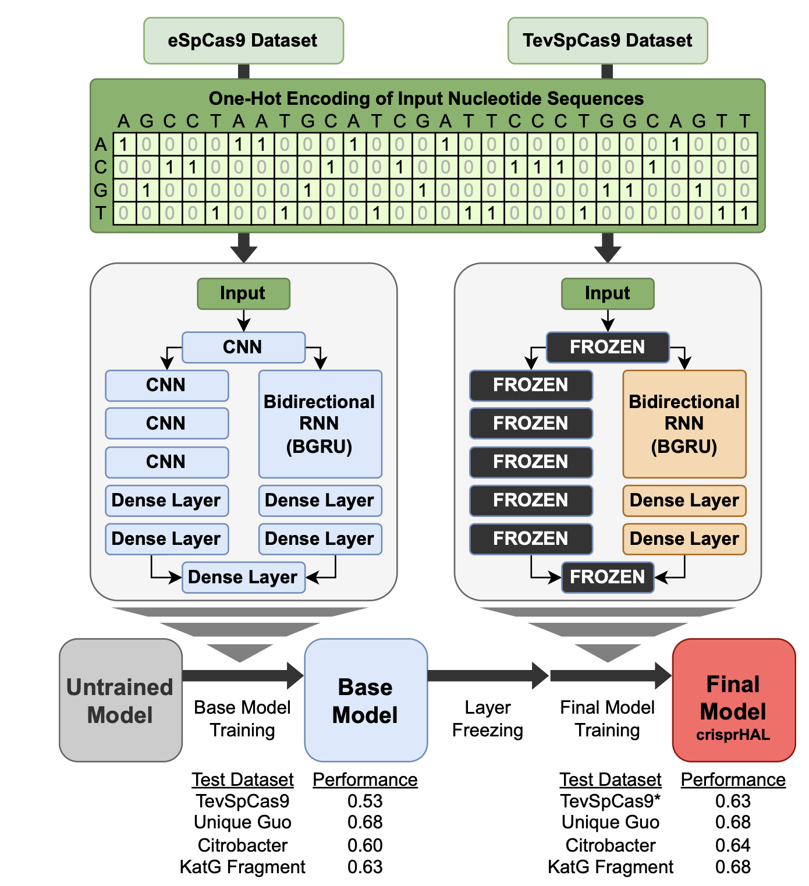
crisprHAL internals

Slide 26
crisprHAL

Slide 27
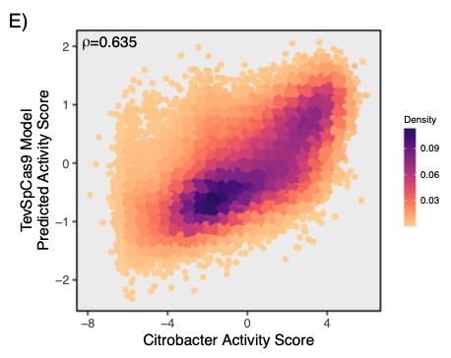
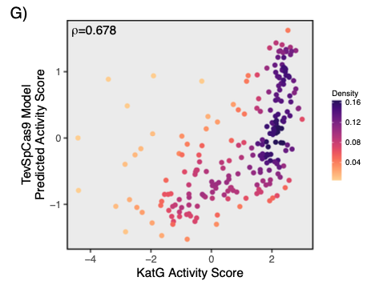
Testing in orthogonal datasets
Depletion
Enrichment
Assay in different species
Depletion experiment
~30000 sgRNA
Assay in E. coli, S. enterica gene segment
Enrichment experiment
~300 sgRNA

Slide 28
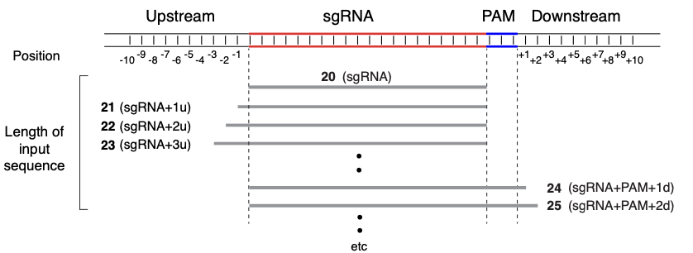
Model length = contact site

Slide 29
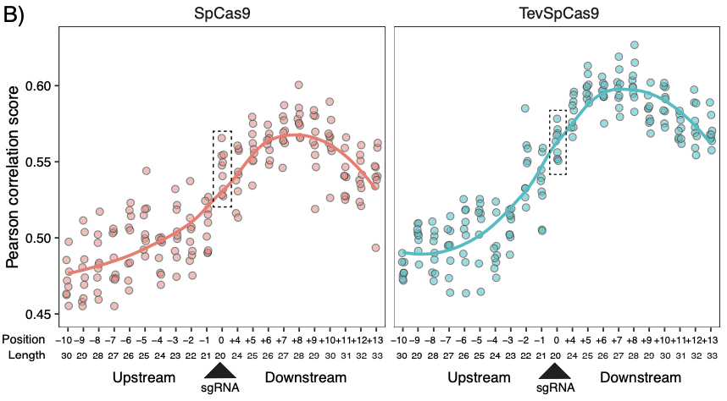
Model length = contact site

Slide 30
Model length = contact site

Slide 31
Summary
HTS data are partially identifiable:
Scale is assumed, wrongly, by all tools to be estimated properly
Accounting for scale prevents shrinking to a known wrong estimate
Better inference is obtained if all parameters are estimated including scale
As a minimum can determine what is robust to scale uncertainty
Uncertainty is not a bad thing if you remember
A – your data are uncertain
B – therefore the results are uncertain
C – therefore your interpretation must allow for uncertainty
D – uncertainty and skepticism should be your default state

Slide 32
Summary
HTS data are a form of partially identifiable data
Scale is assumed, wrongly, by all tools to be estimated properly
Accounting for scale prevents shrinking to a known wrong estimate
Better inference is obtained if all parameters are estimated including scale
As a minimum can determine what is robust to scale uncertainty
Uncertainty is not a bad thing:
A – your data are uncertain
B – therefore the results are uncertain
C – therefore your interpretation must allow for uncertainty
D - ‘Biological systems’ are only as different as they need to be (Jussi)

Slide 33
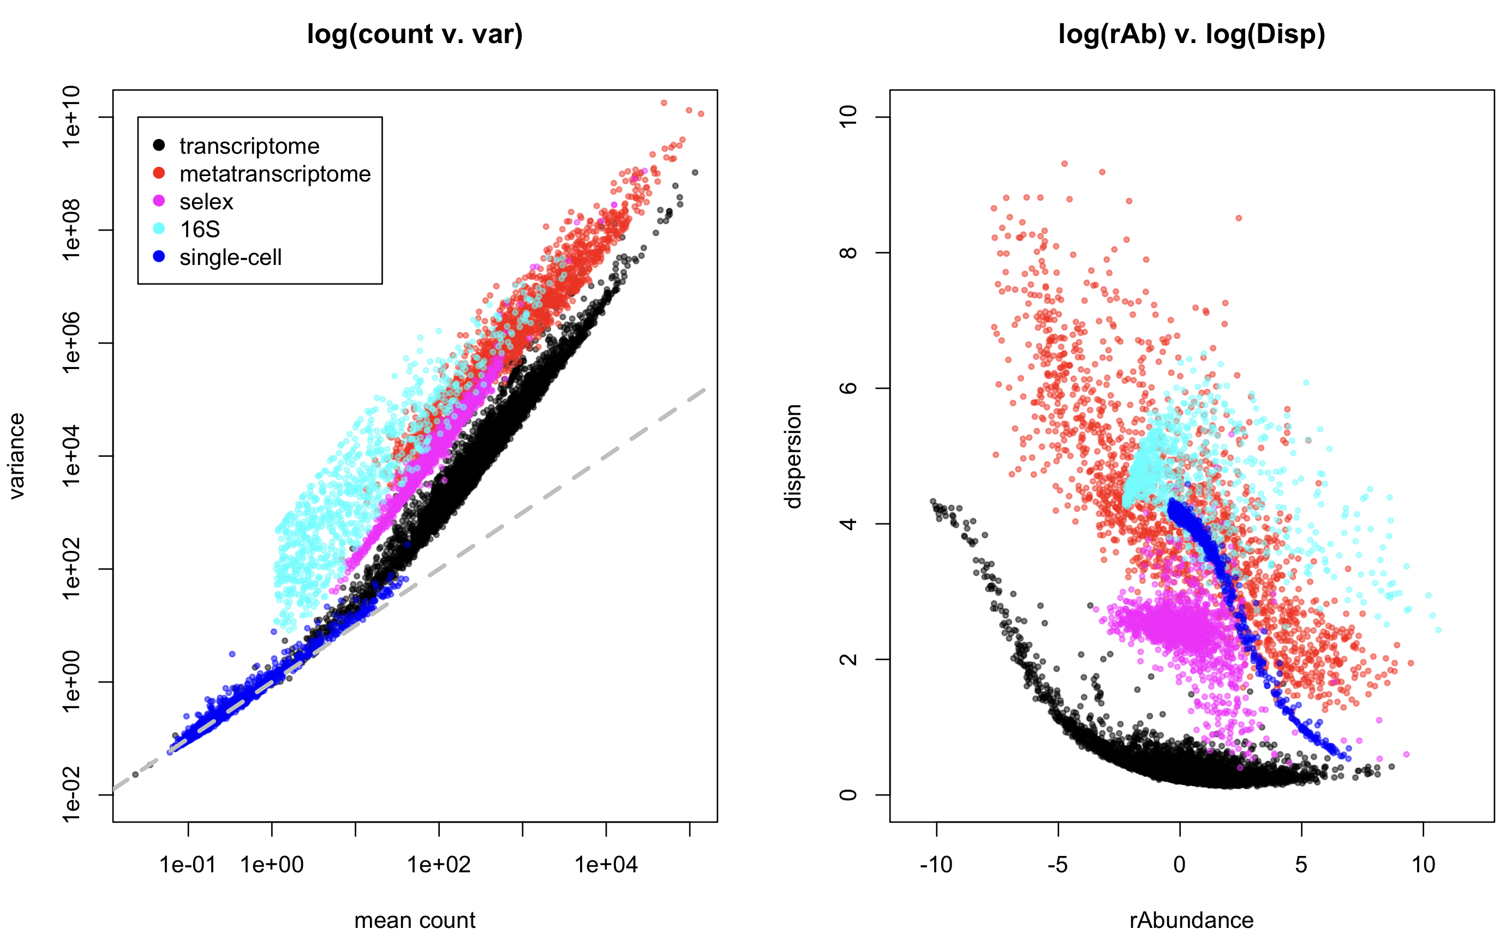
All data are NB, but …

Slide 34
Dispersion vs. space

Slide 35
Adding scale uncertainty …

Slide 36
Adding scale uncertainty …

Slide 37
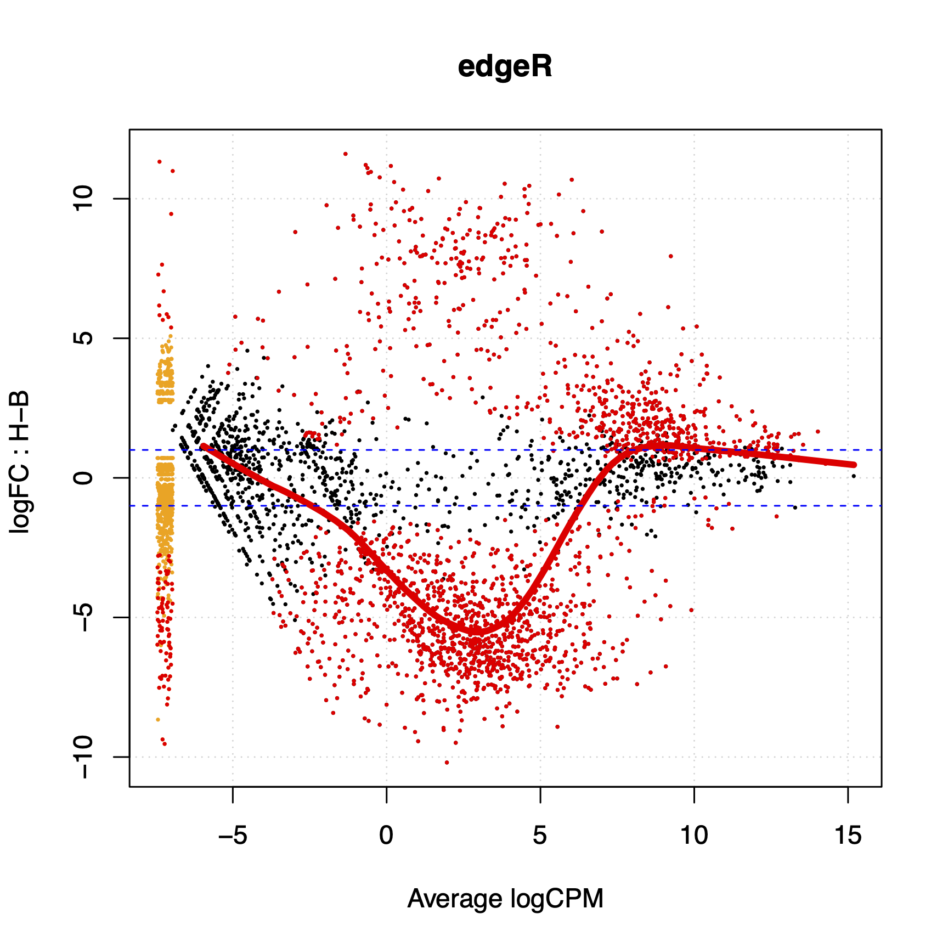
What about my problem?
Scale can be added on a per-group or per-sample basis
Differential scale changes the location of the data
This depends only on the ratio of the scales, not on the value of the scales
Yes, the normalization value is irrelevant but the ratio between the values for different groups is important

Slide 38
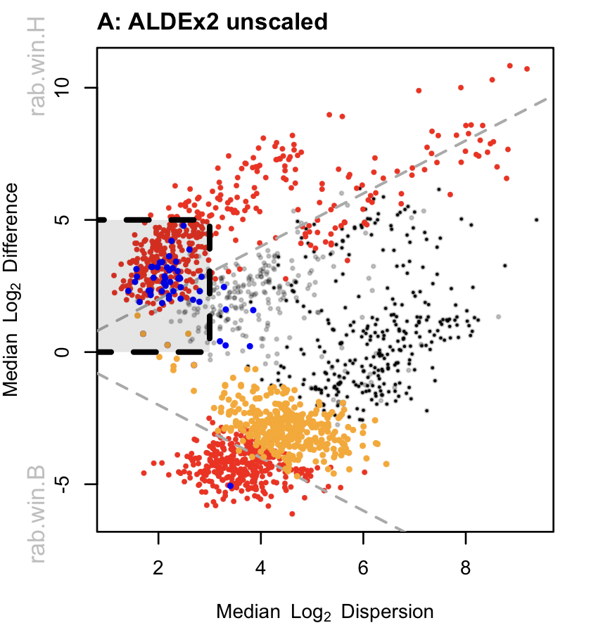
Meta-transcriptomes …
Effect plot
Bit of a mess
Housekeeping genes not centered
HK FP boxed (rRNA, Tsc’n, Gly …)
False negatives not significant
Gamma=NULL

Slide 39
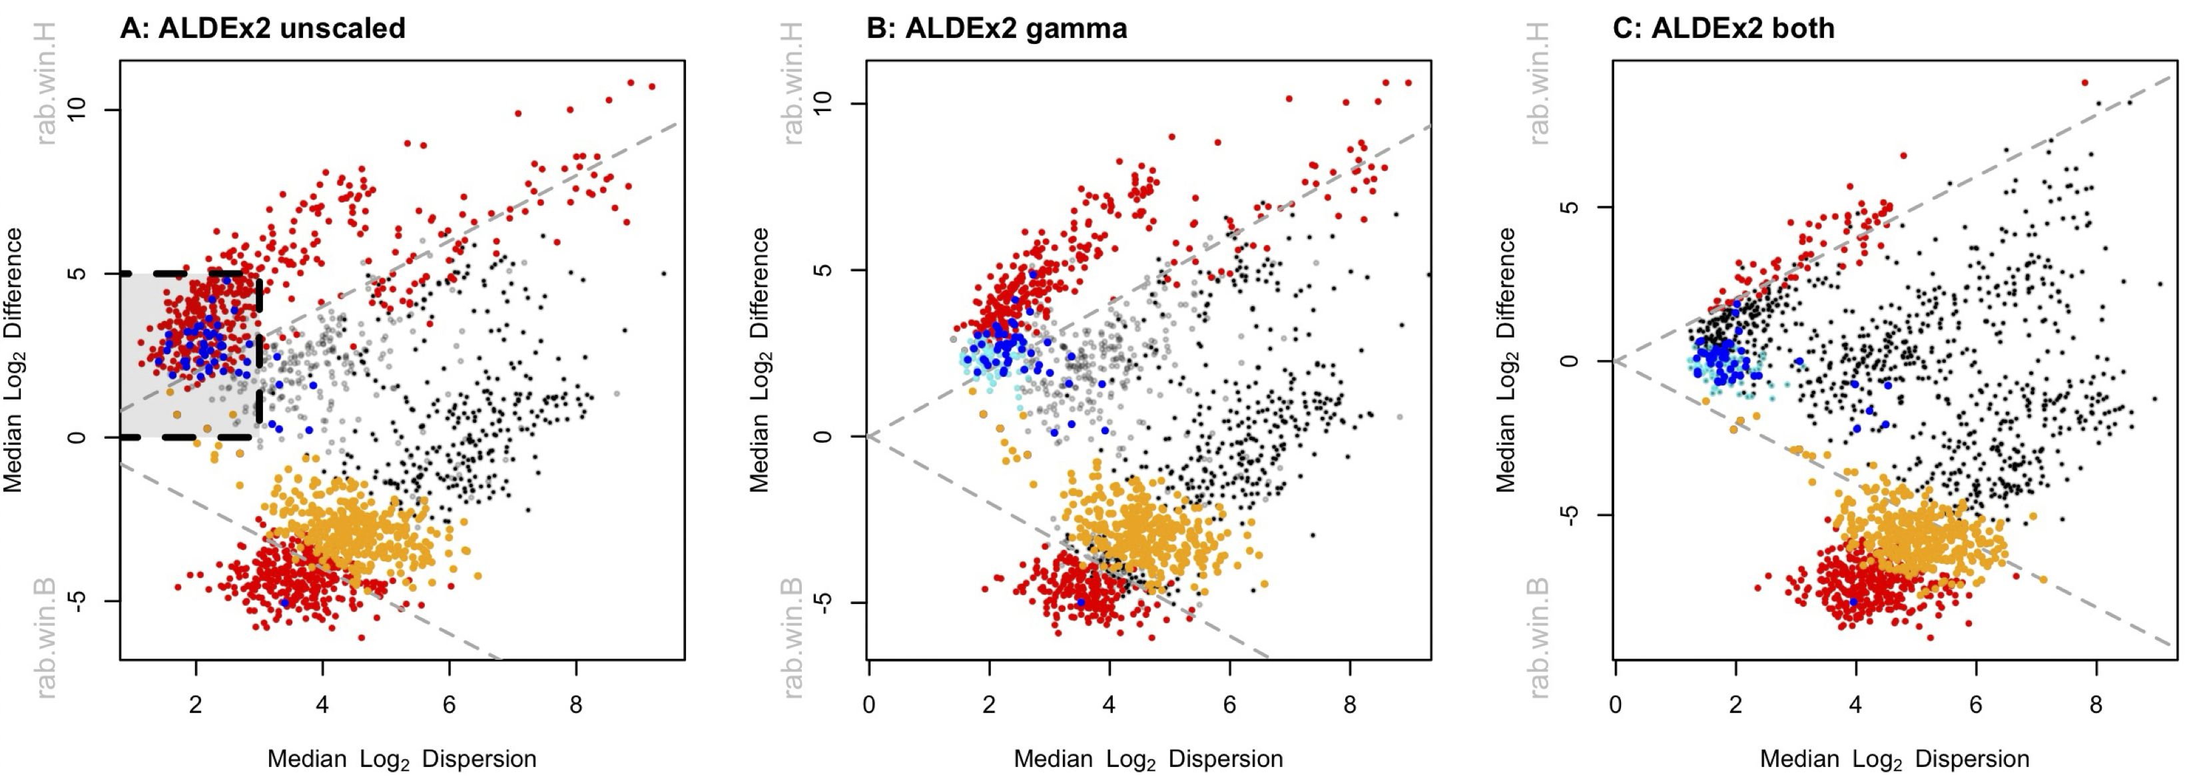
Meta-transcriptomes …
Gamma=NULL
Gamma=0.5
Ratio = 1 : 1
Gamma=0.5
Ratio = 1 : 1.15

Slide 40
Meta-transcriptomes …
CAMP resistance
Metabolism stuff
Nitrogen/Amine metabolism
Gamma=0.5
Ratio = 1 : 1.15

